Slide 1

Architecture final
Cameron, Julia, jude, katherine

Slide 2
goalS
Original Goals
List Processor: Implemented
General Processor: Implemented
N-Body Simulation : Not implemented
Accomplishments:
Modified List Processor
General Processor with modified instruction set
Simple game – close to working

Slide 3
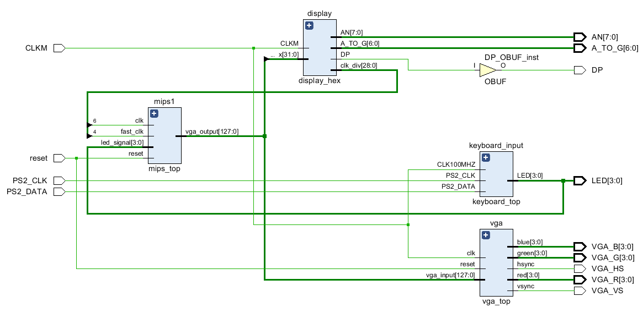
I/O

Slide 4
I/O
Input:
Keyboard
Arrow keys change the direction of the drawn item
Output:
7 Segment Display
Demonstrated the y coordinate changing
LEDs
Shows the current keyboard input
VGA
The position of the item is changed every cycle and this is reflected on the screen

Slide 5
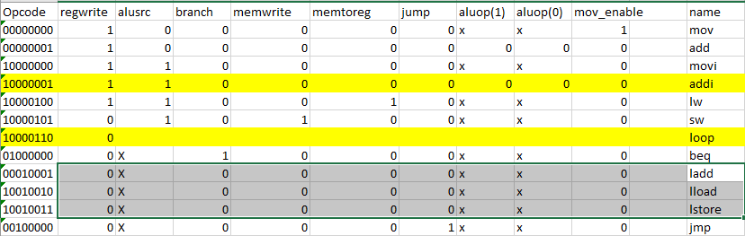
Basic Instruction set

Slide 6
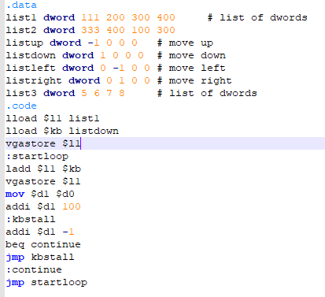
Basic Instruction set

Slide 7

Program Demo

Slide 8
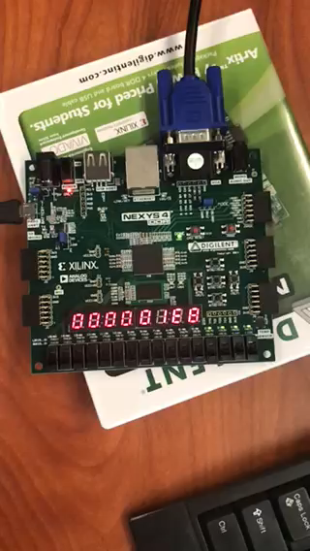

Slide 9
challenges
Challenges
Successes
Interfacing successfully with the keyboard
Debugging a real time application that uses waits
Differences between simulation and implementation
Vivado???????
Overcame many difficulties
Squashed many bugs
Learnt a lot of lessons about Vivado + VHDL

Slide 10
Final thoughts
Difficulty can be hard to gauge
Design changes over time
This project has been about the journey, not necessarily the destination
Pair programming is amazing
Creating a working microprocessor is difficult
It pays to seriously think about one’s compiler

Slide 11

Thank You
<chinchilla here>

